Slide 1

Analysis on Public Library Data using Python
This presentation analyzes a public dataset on Connecticut libraries using Python, pandas, seaborn, and scipy. It mainly focuses on EDA and Testing of Data
by
Aditya Arora
12324327 / 10
K23DW

Slide 2
Introduction to
Objectives
1
Exploratory Data Analysis (EDA)
Understand the underlying structure and patterns using Python.
2
Meaningful Visualizations
Create heatmaps and boxplots to reveal relationships and distributions.
3
Statistical Hypothesis Testing
Conduct Test to fail and pass hypothesis
4
Interpret and explain Statistical Results
Use numerical outcomes and visual representation.
5
Real-World Applications
Figure out future work and similar areas

Slide 3
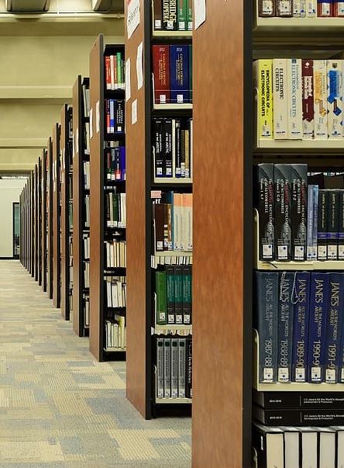
Overview of the Dataset
Dataset Source
Sample Columns
Public Libraries
Library, County, Population, Total Visits
…
Types of Data
Size & Structure
Mostly numeric + categorical
Columns: 28
Rows: 5105

Slide 4

Objectives
1
Exploratory Data Analysis (EDA)
Understand the underlying structure and patterns using Python.
2
Meaningful Visualizations
Create heatmaps and boxplots to reveal relationships and distributions.
3
Statistical Hypothesis Testing
Conduct z-tests, paired tests, and binomial tests.
4
Real-World Applications
Propose future directions based on the analysis.

Slide 5
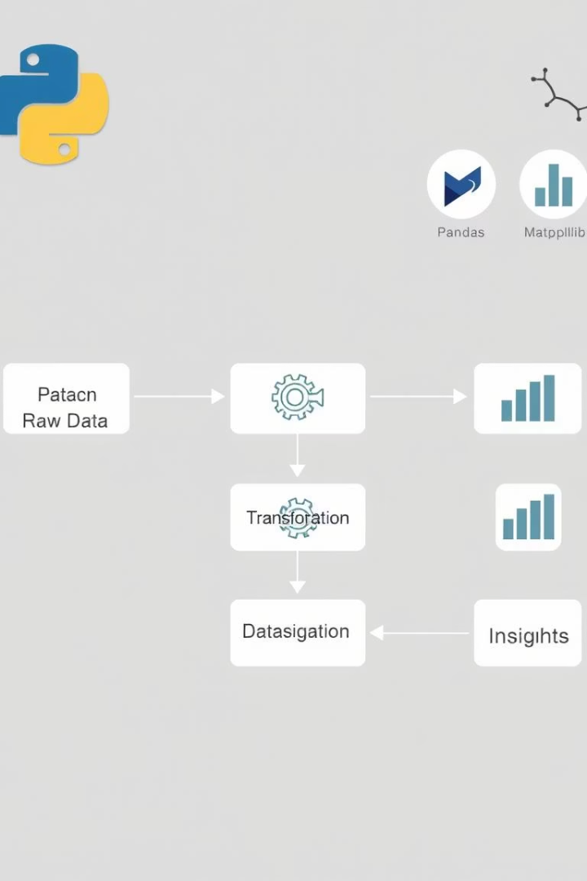



Methodology Used
Data Cleaning
Handling missing values.
Visualization
Creating heatmaps and boxplots.
Statistical Testing
Applying t-tests and more.
Data Collection
Importing Dataset information for analysis

Slide 6
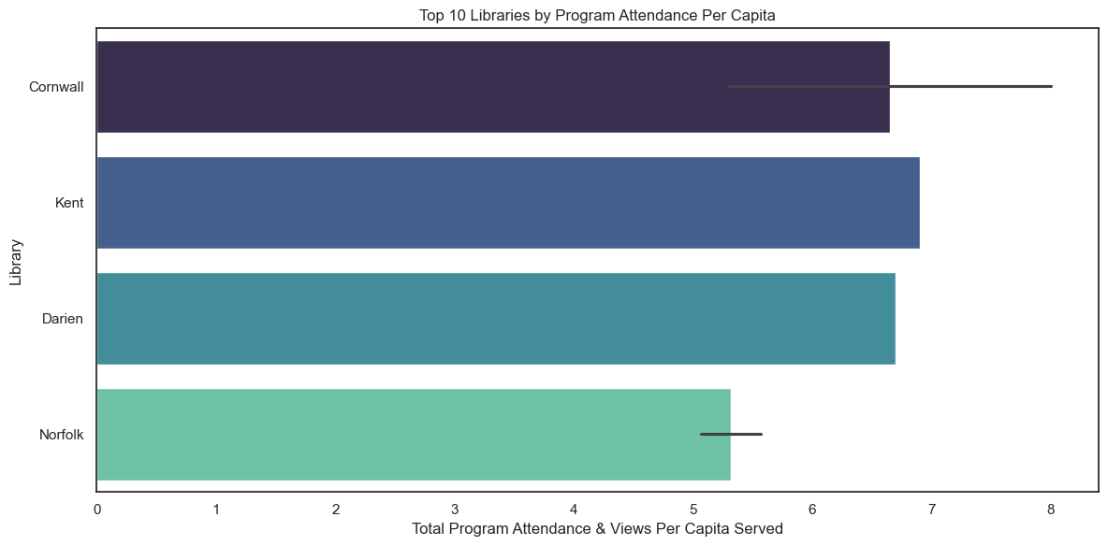
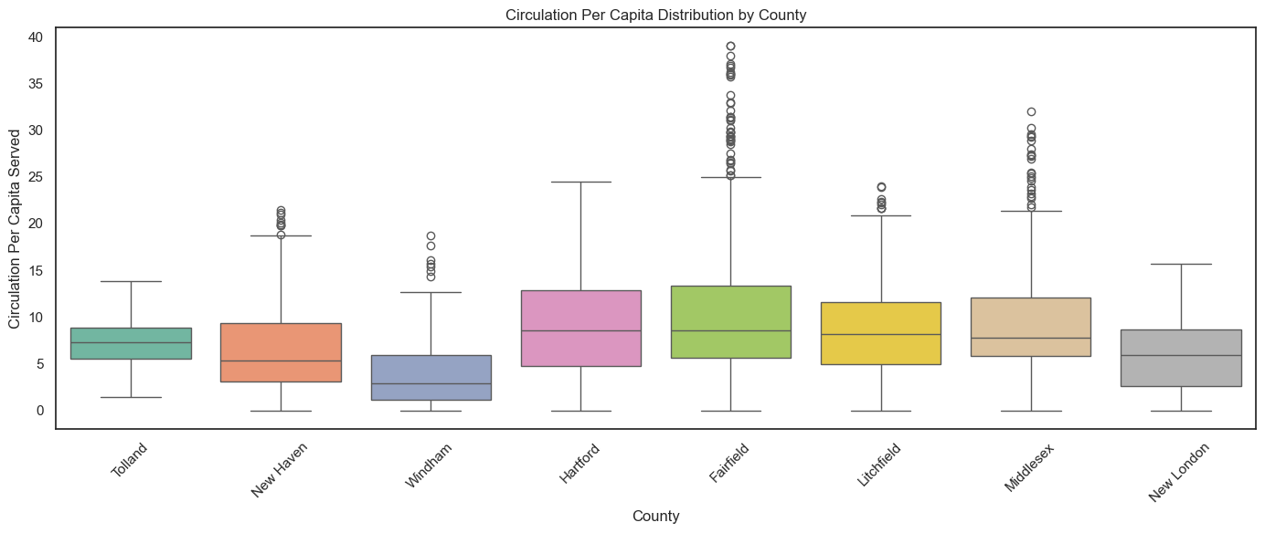
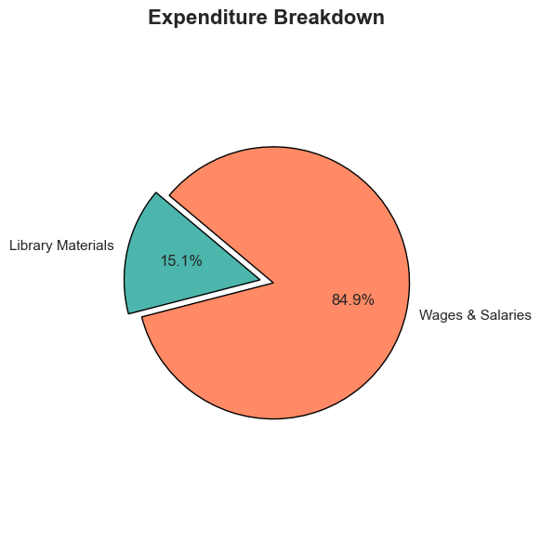
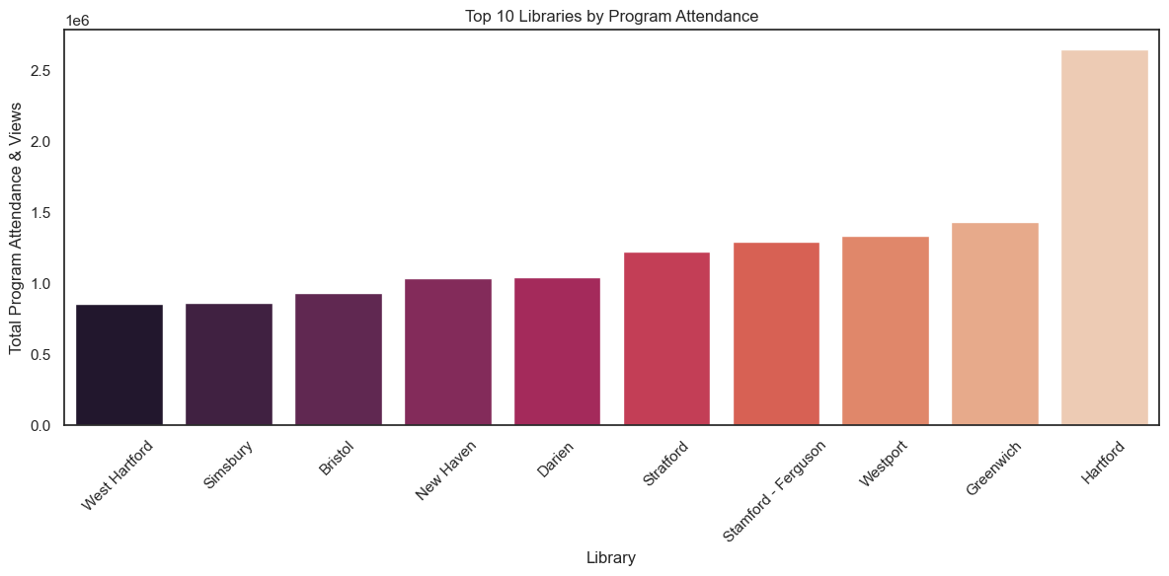

Slide 7
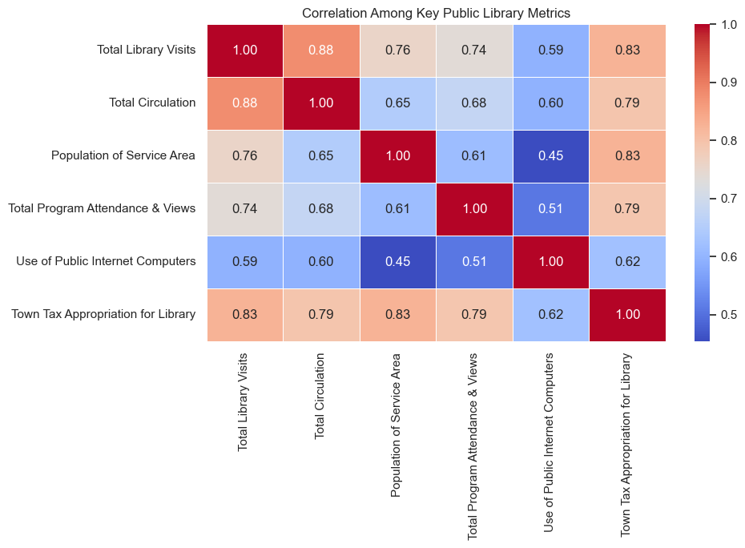

Slide 8
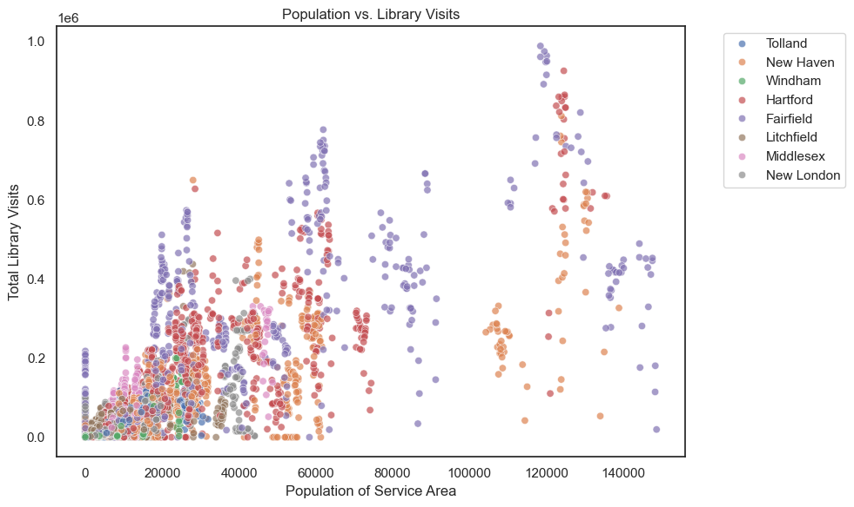

Slide 9
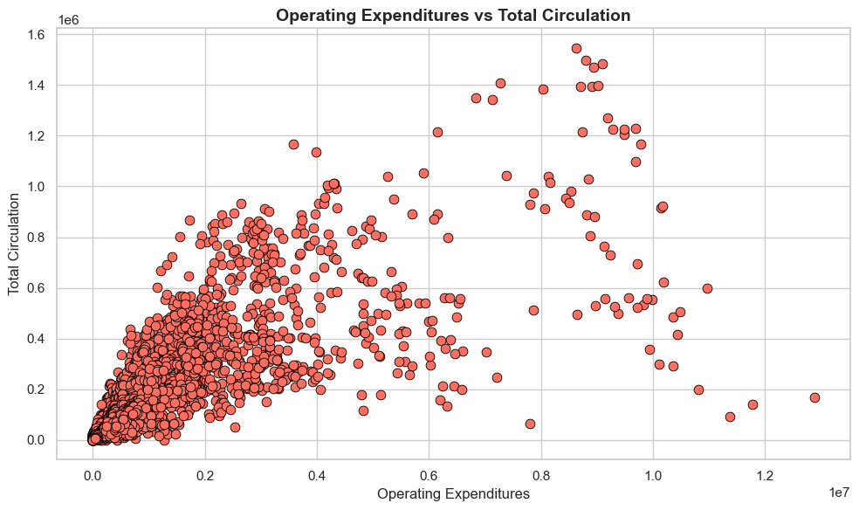
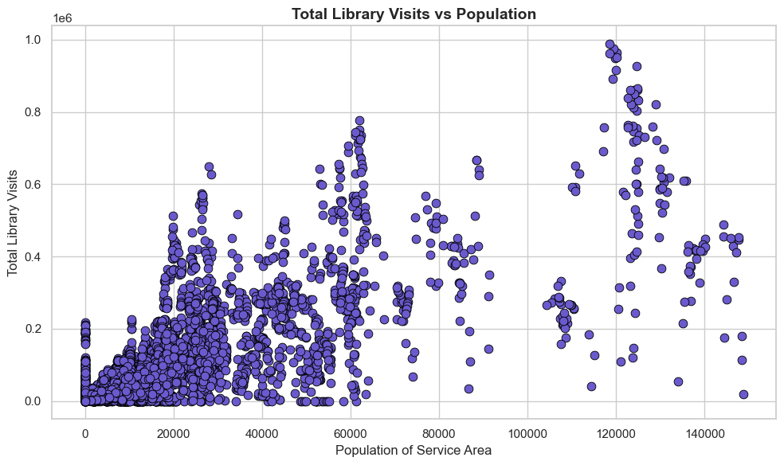
Exploratory Data Analysis

Slide 10



Future Scope
Adding more variables
2
Include Literacy Rates, Education level to enrich the analysis
Multi-Year Data
1
Check on differences in library
usage post-pandemic
Digital Services
3
Evaluate the impact of e-books
and online programs

Slide 11

Applications
Policy Making
Library Mgmt Details
Used to better allocate funds
What programs engage users the most?
Educational Research
Academic Projects on public services effectiveness,
i.e. Urban vs Rural Engagement

Slide 12
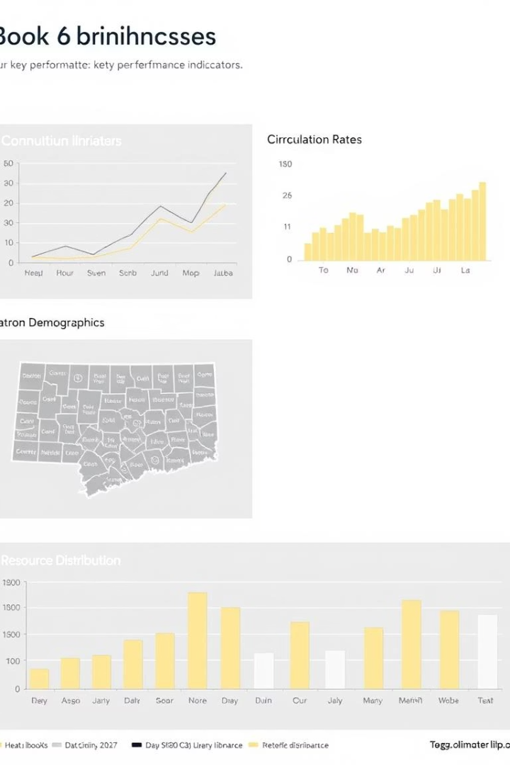
Conclusions
Library Usage & Reach
Program Engagement
Higher Population ->
More Visits
Diverse & Frequent Programs->
Surge in attendance per capita
Internet Access Utilization
Highest-> in libraries serving rural populations
Equity in Access
Smaller Populations-> Higher per capita metrics: personalized
and intensive service
Funding Sources & Income
Expenditure Focus
Tax-> Library operating income
More Taxes-> Better Engagements
Majority Budgets (60%)->
Wages, Salaries

Slide 13
Thank you

